Slide 1
Shop The Dress:Fashion Recommender System for an ecommerce website

Slide 2
Relevance of topic
In recent years, the textile and fashion industries have witnessed an enormous amount of growth in fast fashion. On e-commerce platforms, where numerous choices are available, an efficient recommendation system is required to sort, order, and efficiently convey relevant product content or information to users. Image-based fashion recommendation systems (FRSs) have attracted a huge amount of attention from fast fashion retailers as they provide a personalized shopping experience to consumers. The available studies do not provide a rigorous review of fashion recommendation systems and the corresponding filtering techniques. In addition, this review also explores various potential models that could be implemented to develop fashion recommendation systems in the future.

Slide 3
Description of the project
Clothing is an integral part of our life and it is important to choose clothes that suit our body. In today’s world, a wide variety of clothing are available offline as well as online. But the real challenge is to choose the ones that suit us. By understanding the type of body shapes and what styles flatter and compliment particular body shapes, everyone surely can work with their body to give off amazing looks. This fashion recommendation system aims at constructing an e-commerce website for a boutique located at Thrissur and then make a fashion recommender system for the client .

Slide 4
Objectives
The textile and apparel industries have grown tremendously over the last years. Customers no longer have to visit many stores, stand in long queues, or try on garments in dressing rooms as millions of products are now available in online catalogs. This is an effective recommendation system is necessary to properly sort, order, and communicate relevant product material or information to users. Effective fashion RS can have a noticeable impact on billions of customers' shopping experiences and increase sales and revenues on the provider-side.

Slide 5
Existing System
Recommendation based on user’s previous choice
That is , similar items are only recommended
Body measurements and body shape are not considered
Seasons are not considered

Slide 6
Proposed System
Fashion Recommendation based on body shapes
Body measurements are taken as input from the user
Predicts body shape according to the given input
According to the predicted body shape , predicts suitable dresses for both summer and winter
Seasons are considering

Slide 7
Input
Height:
Bust :
Waist:
Hip:

Slide 8
Output
Alamkar boutique
Home About Register Login Contact
Shop Now

Slide 9
Modules identified
Admin module
Admin can directly login using their email id and password
Add product: new products can be added
View products: view existing products
Registered users : names ,email and contact numbers of registered users can be viewed
Orders : existing placed orders can be viewed
Feedback: a fill out form will be there to write the comment in the message box on user page and that can be viewed by the admin

Slide 10
Modules identified
2. User module
Profile : details entered while registering can be updated here
Fashion: measurements of body are taken as input from the user
Collections: added products by the admin can be viewed here
Cart: products added to purchase can be viewed here
Payments: payments details are here
Contact: This is an option to write feedback

Slide 11
Algorithm
Decision Tree Algorithm is used to build the system.
The goal of using a Decision Tree is to create a training model that
can use to predict the class or value of the target variable by learning
simple decision rules inferred from prior data(training data).

Slide 12
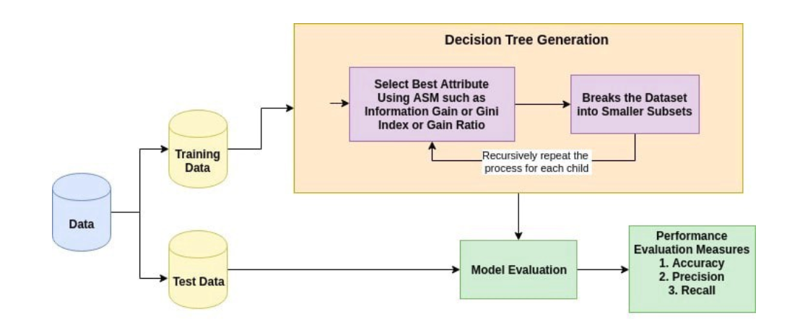
Algorithm

Slide 13
Dataset
Here 2 datasets are using.One is for predicting body shape . Other is for recommending dresses according to the predicted body shape.
Dataset for predicting body shape : https://github.com/facebookresearch/VIBE/blob/main/dataset/humans/model.json
Dataset for recommending dress:
Created my own

